Slide 1

Notes:
1st slide (Mandatory)

Slide 2

Josephus trap
In computer science and mathematics, the Josephus Problem (or Josephus permutation) is a theoretical problem.
The problem statement:
There are n people standing in a circle waiting to be executed. The counting out begins at some point in the circle and proceeds around the circle in a fixed direction.
How is the Josephus problem solved?
The Josephus problem can be solved using recursion. For each iteration, recursively delete the Kth position until only one person is left.

Slide 3
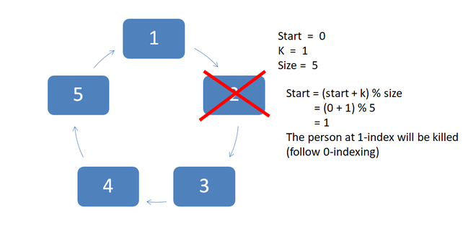
Example Diagram

Slide 4
import java.io.*;
class Main {
static int josephus(int n, int k){
if (n == 1)
return 1;
else
return (josephus(n - 1, k) + k - 1) % n + 1;
}
public static void main(String[] args){
int n = 14;
int k = 2;
System.out.println("The chosen place is "
+ josephus(n, k));
}
}
Output
The chosen place is 13

Slide 5

THANK YOU

